Slide 1
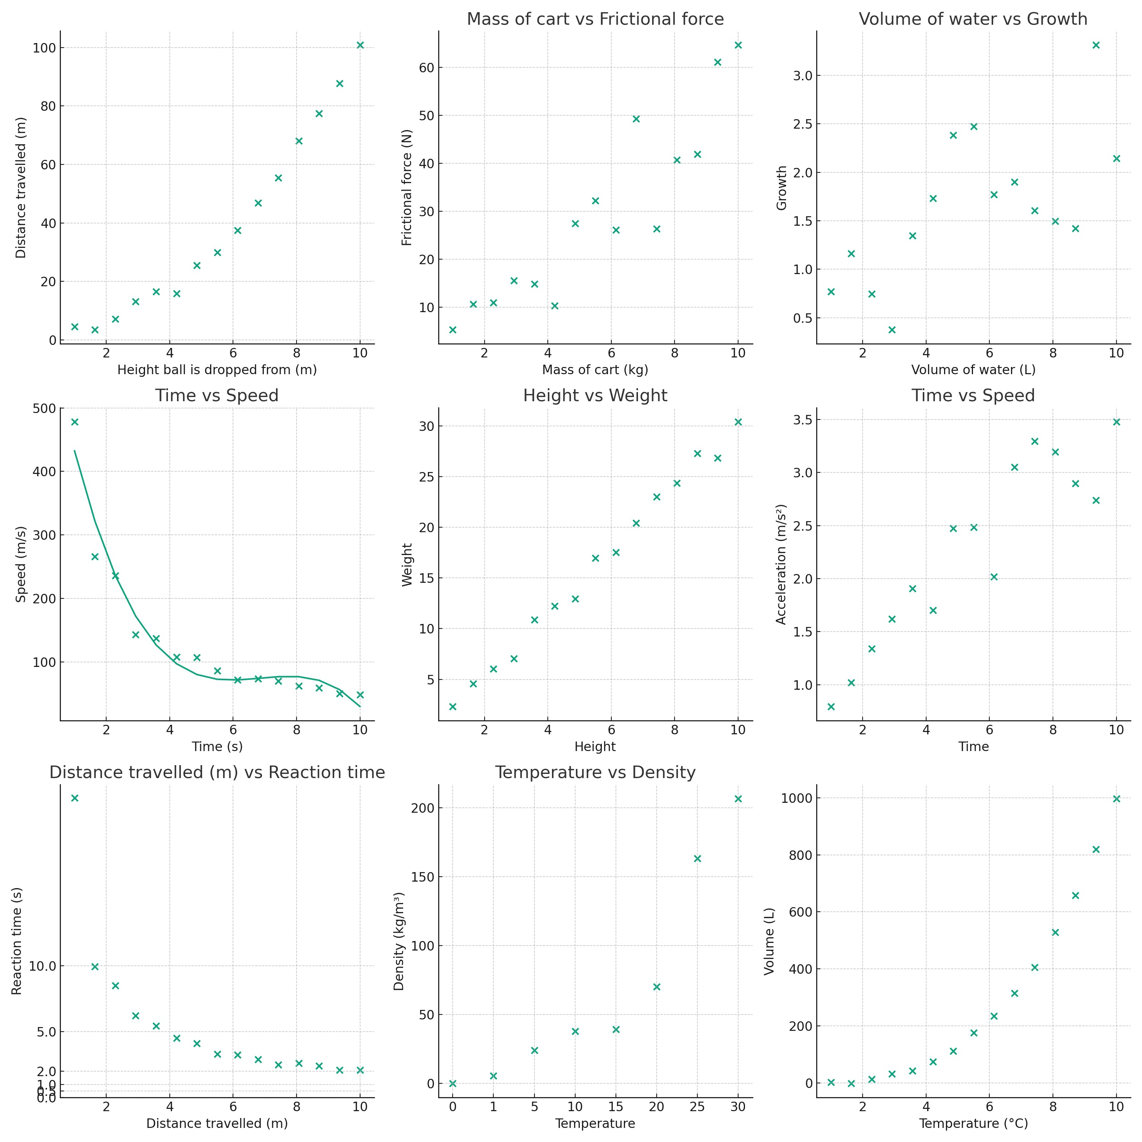
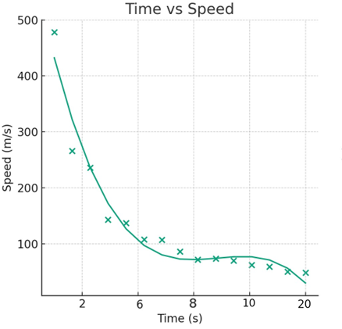
Scientific Plotting
Name:
Remember each graph needs a title, axis titles with units, consistent scales and plotted data.
For each graph below, identify what is missing or incorrect. Fix it if you can.
What is wrong?
What is wrong?
What is wrong?
What is wrong?
What is wrong?
What is wrong?

Slide 2
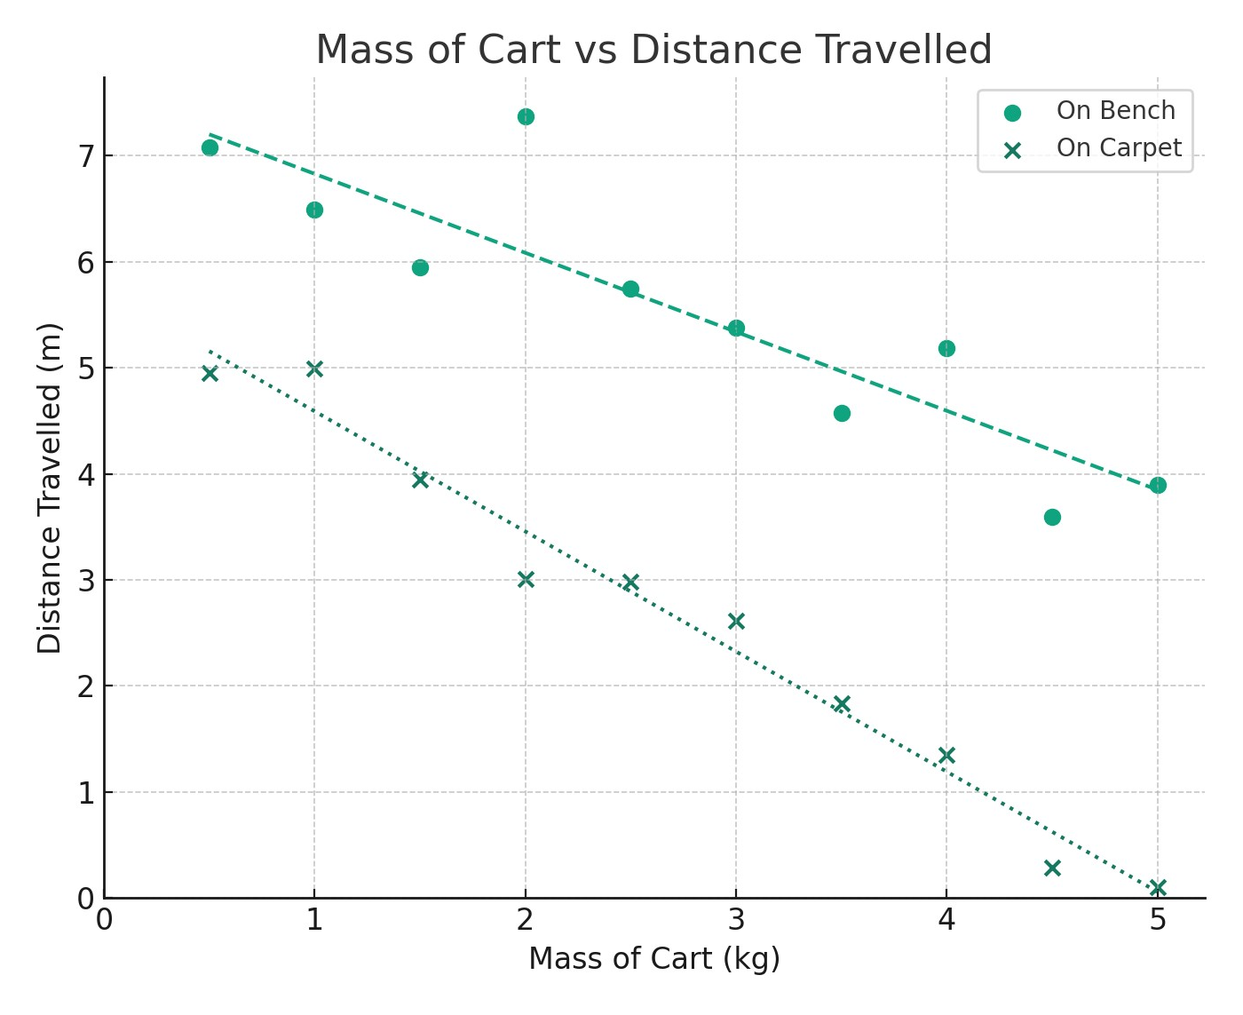
Scientific Plotting
Answer the questions using the graph below:
1) Describe how distance travelled changes as the mass of cart increases.
2) How far did the 1kg cart travel on the bench?
3) How far did the 2.5kg cart travel on the carpet?
4) How far did the 3.5kg cart travel on the bench?
5) Using the line of best fit, how far would you expect a 1.75 kg cart travel on the bench?
6) A cart travelled 3.5m on the carpet. Using the line of best fit, what mass would you expect the cart to have?
7) Describe how the results are different between bench and carpet.
8) Why might the cart travel different amounts when it is on different surfaces?
9) Why it is better to use a scatter plot for this data instead of a column plot?

